Slide 1

Capstone project Reimbursement Portal - python
By – Dikshita Patidar

Slide 2
Introduction
Reimbursement portal is a platform where employees can claim reimbursement’s for various expenses.
These claims are approved/rejected by assigned manager’s, adhering reimbursement policy.

Slide 3
Functional Requirements
Three types of users : Admin , Manager , Employee
Registration and login flows for Managers and Employees with valid company email.
Submission of reimbursement requests by Employees, including details and relevant documents according to policy.
Approval or rejection of requests by assigned Managers with comments.
Admin functionalities for managing users, departments, and tracking reimbursement record.

Slide 4
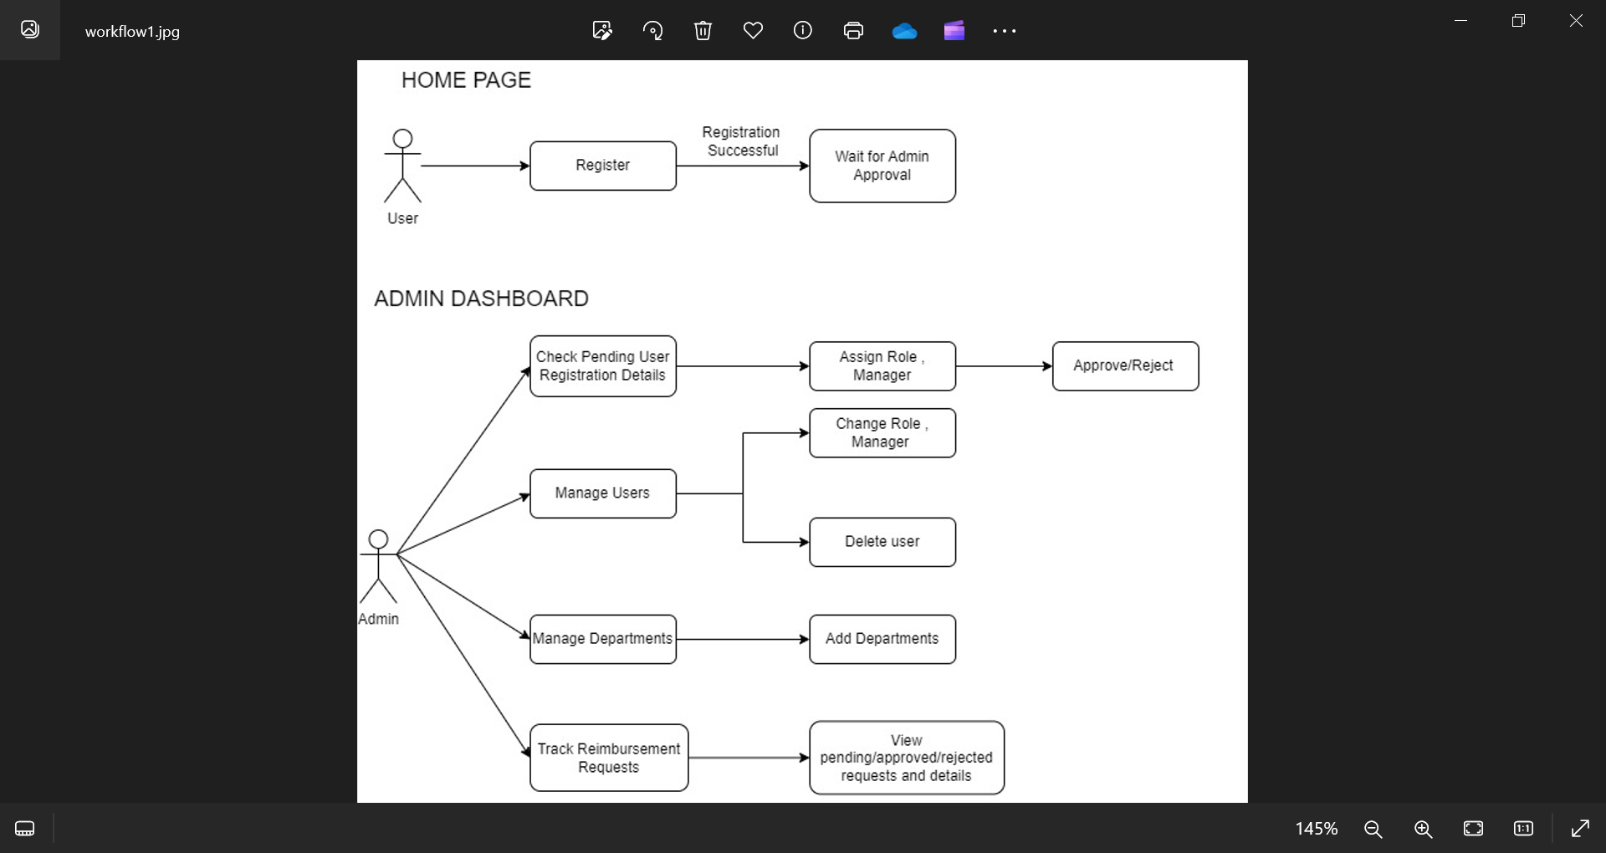
Workflow

Slide 5
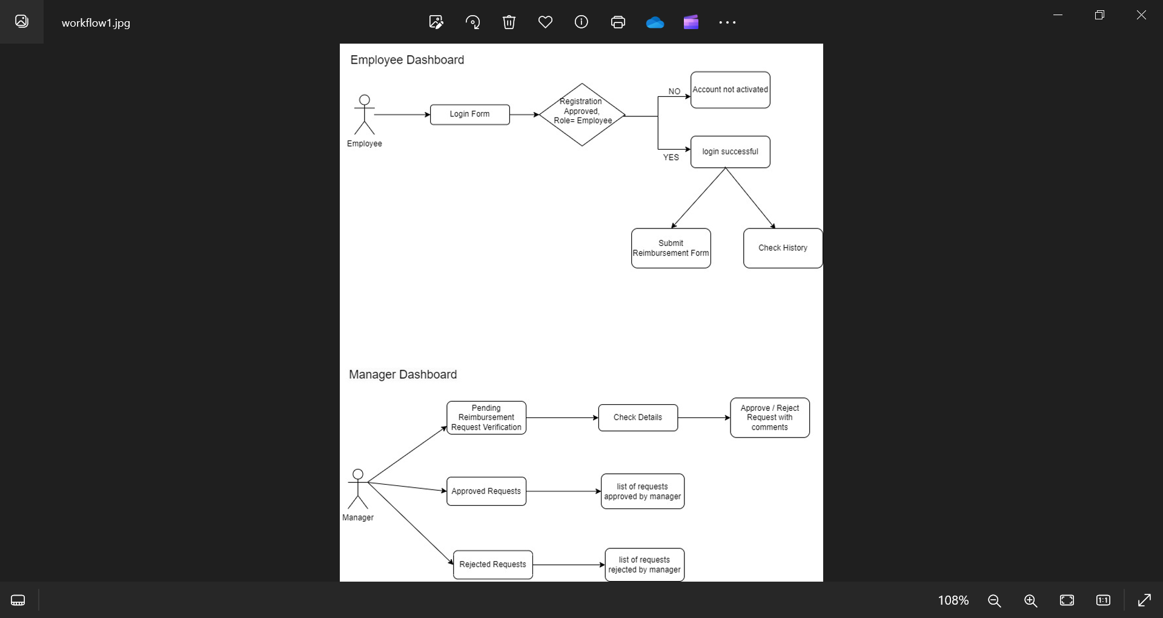
Workflow

Slide 6
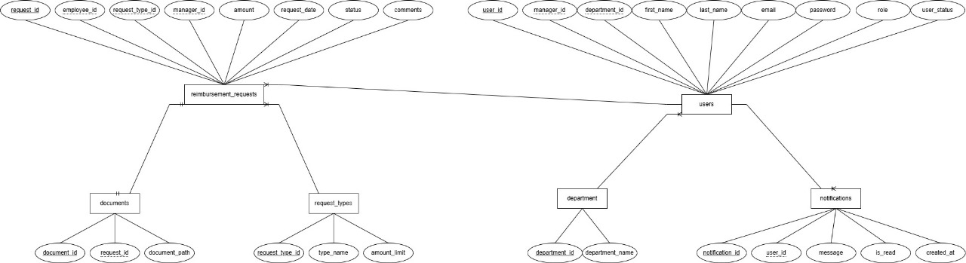
ER DIAGRAM

Slide 7
USER TABLE
Column | Data Type
user_id (Primary Key) | int
first_name | varchar(50)
last_name | varchar(50)
email | varchar(100)
password | varchar(255)
role | varchar(50)
user_status | varchar(20)
manager id (Foreign Key) | int
department id (Foreign Key) | int

Slide 8
Reimbursement Request table
Column | Data Type
request id (PK) | int
employee_id (FK) | int
request_type_id (FK) | int
amount | float
request_date | date
status | varchar(20)
manager_id (FK) | int
comments | text

Slide 9
DEPARTMENT TABLE
DOCUMENT TABLE
Column | Data Type
department_id (PK) | int
department_name | varchar(100)
Column | Data Type
document_id (PK) | int
request_id (FK) | int
document_path | varchar(255)
REQUEST TYPE TABLE
Column | Data Type
request_type_id (PK) | int
type_name | varchar(50)
amount_limit | float

Slide 10
Technologies used
Frontend - HTML , CSS
Backend – Flask, SQL Alchemy
Database – MySQL
Logging Library to log various events
Platform – VS Code

Slide 11
THANKYOU

